Slide 1
2. Why we do?
Therefore, Score was born and developed to support users:

Slide 2
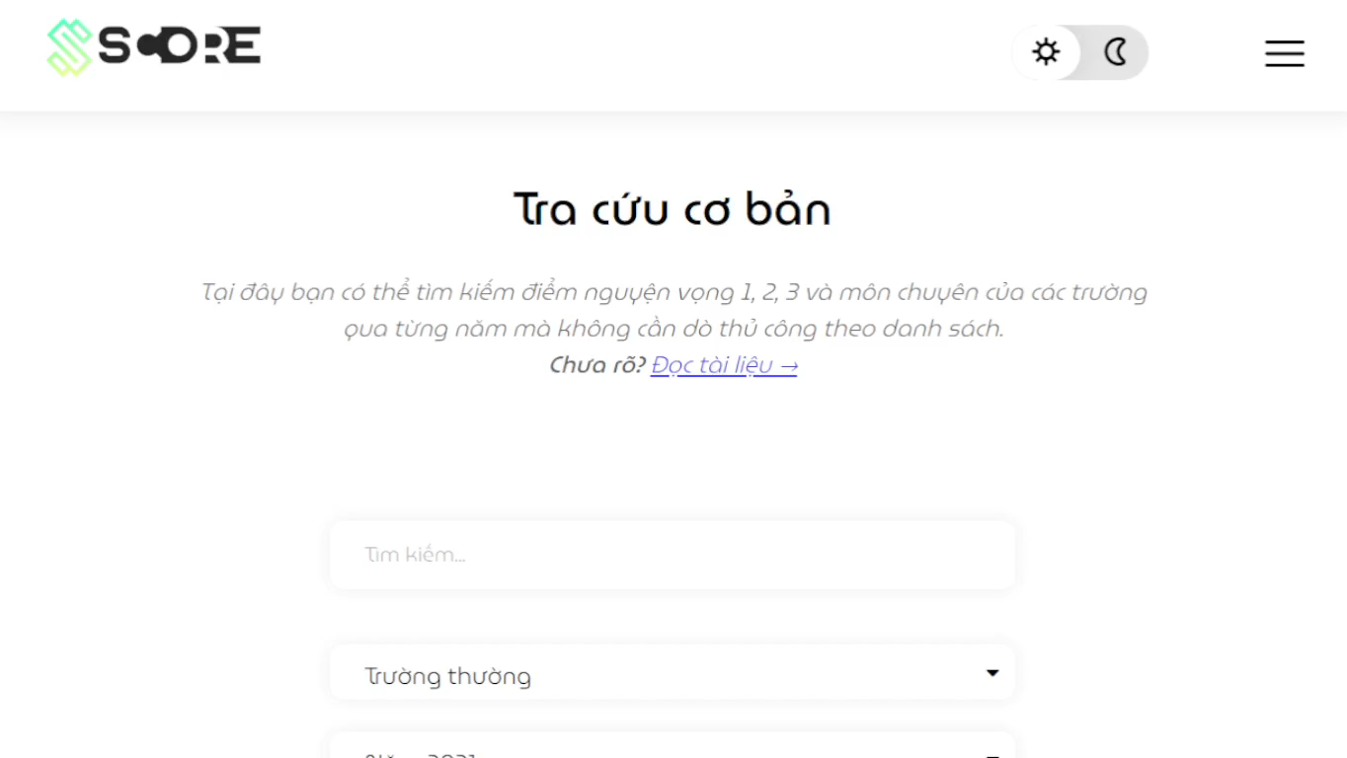
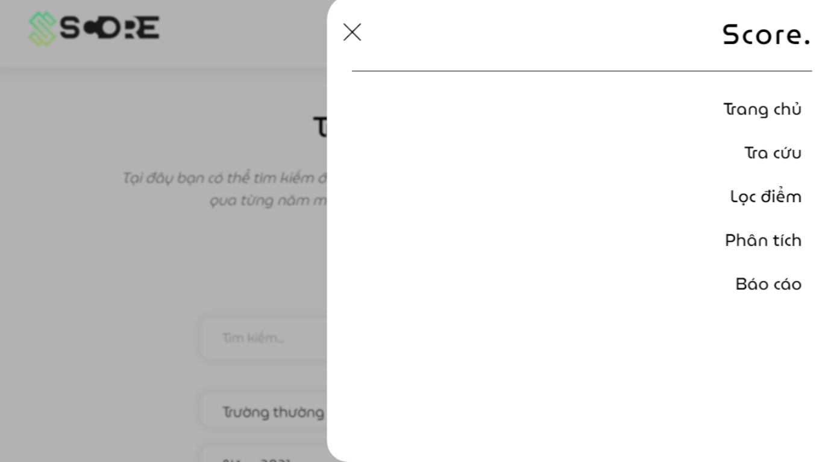
2. Why we do?
Therefore, Score was born and developed to support users:
- Scores data from 2015 to present and perform in the most visual way
- Analysis functions (sorting, statistics, filtering, ranking)
- Give suggestions for selecting schools based on score estimates and location
3. How we do?
Notes:
Therefore, Score was born and developed to support users:
Compile admission scores data for the years from 2015 to the present and perform in the most visual way.
Combine data analysis functions (sorting, statistics, filtering, ranking,…) so that users quickly grasp the meaning and correlation of data.
Give suggestions for selecting schools based on score estimates and location.

